Slide 1



Applied Data Analysis (CS401)
Lecture 1
Intro to ADA
20 Sep 2023
Robert West
Notes:
[2020: just about 1 minute over in total; first half: 50-55 min]
[2021: 90 min; 15-min break; first half: 59 min]
[2022: 85 min; 15-min break]
[2023: 89 min; 15-min break]

Slide 2


Important websites
http://ada.epfl.ch
Your main entry point. All materials linked from there.
https://go.epfl.ch/ada2023-ed
Main communication channel. Sign in with your EPFL email address (or simply access via Moodle).
https://github.com/epfl-ada/2023
Used for homework, project, and final exam.

Slide 3
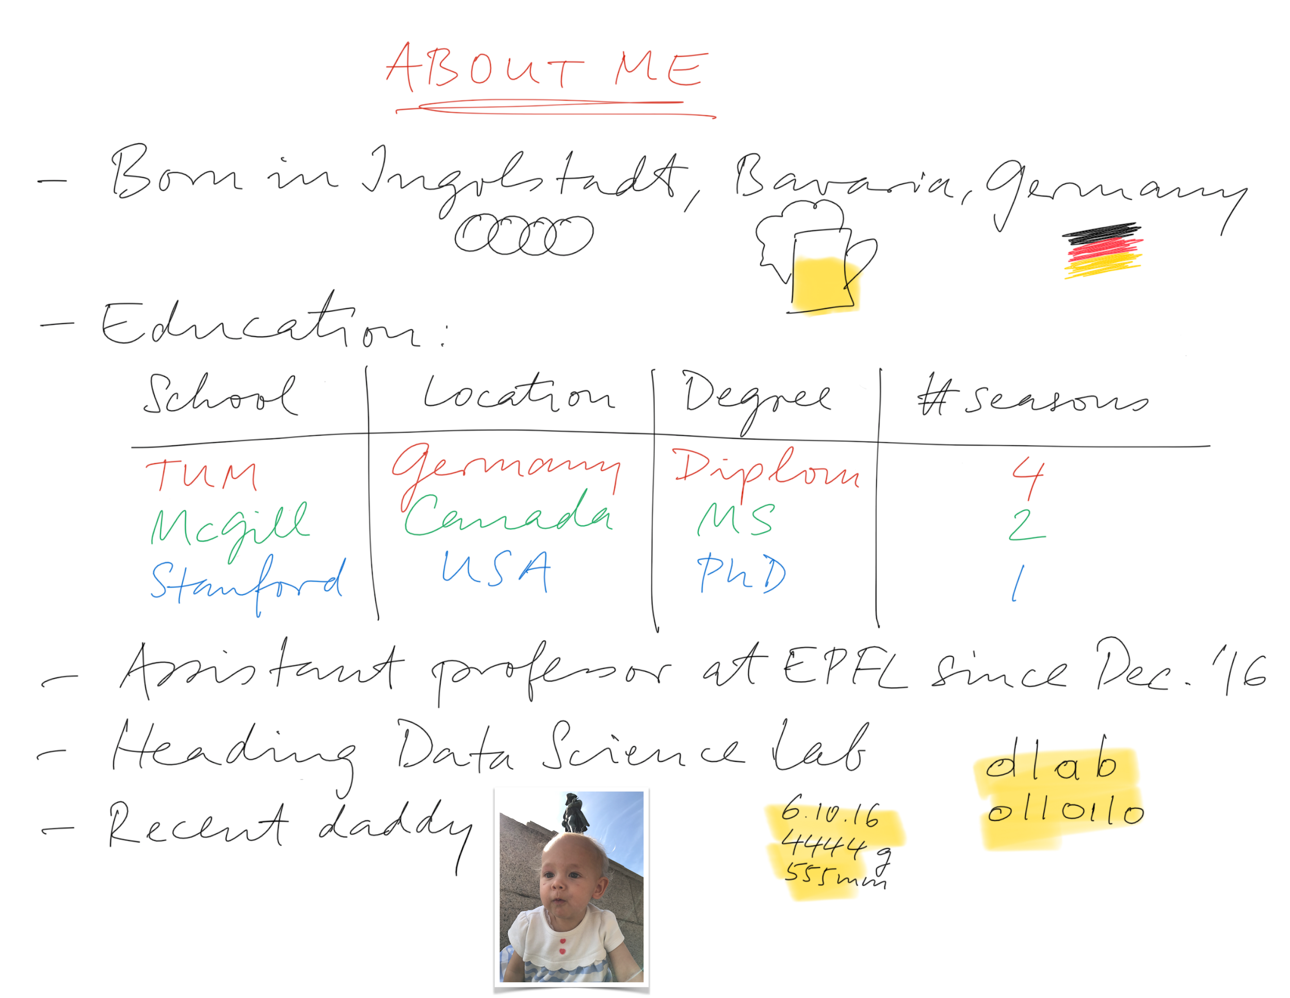



Notes:
At Stanford: internships at Google, Yahoo, Microsoft; worked closely with WMF
All have changed logo -- and now even EPFL!

Slide 4
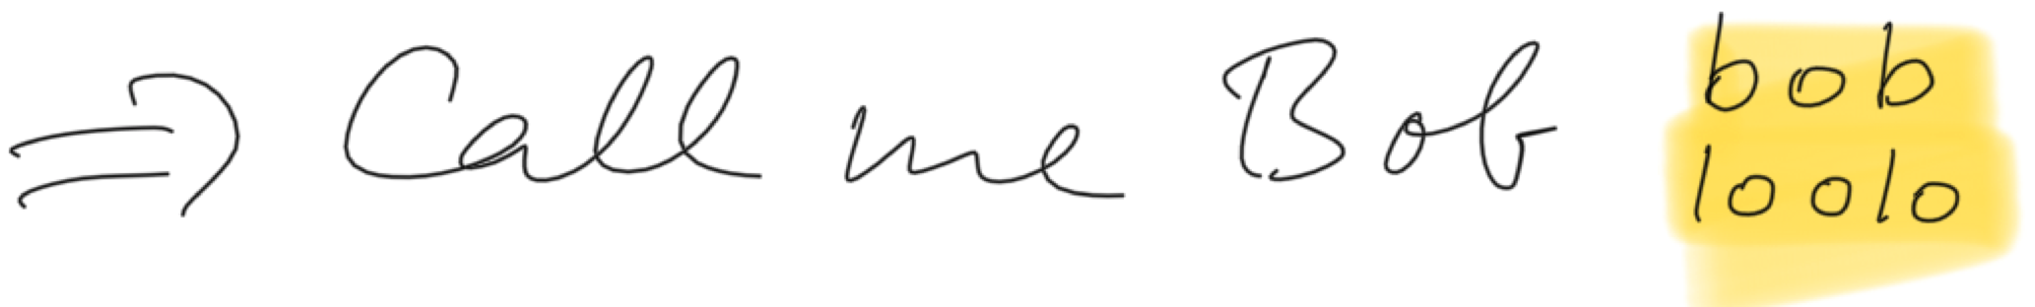
Notes:
Also: ADA

Slide 5
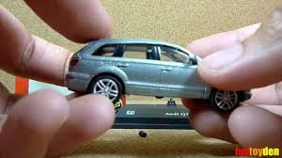
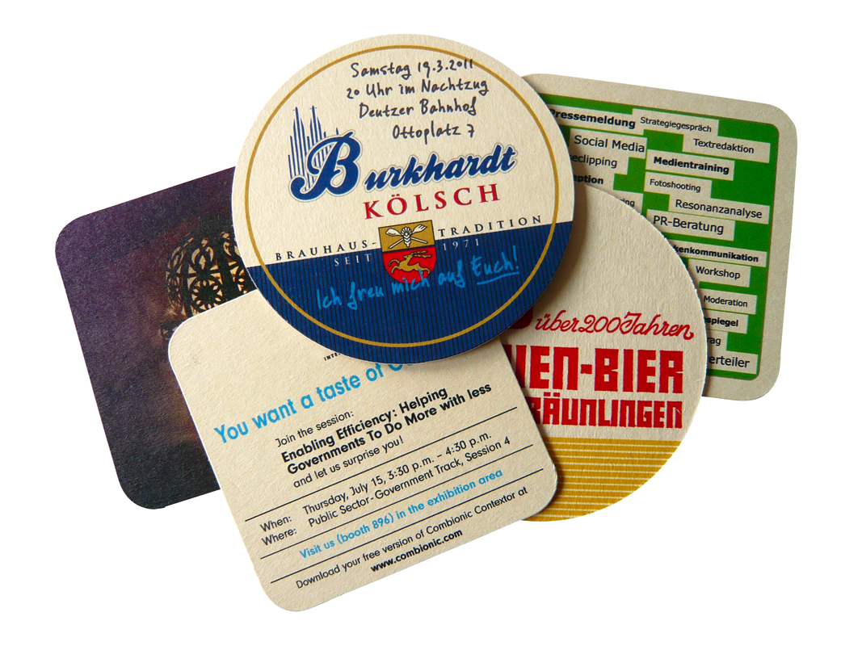
My path toward data science
Notes:
Collector’s mind
Coasters: rich, structured data; Excel spreadsheet
Early adopter of Internet within community: advantage
Spamming people by scraping email addresses (by hand, writing them on a piece of paper)
Did stupid parts of data science, in a stupid way
But not ashamed of it: Vapnik anecdote
I sold my entire collection (thousands of coasters) for a fistful of dollars before moving from Germany to Canada,
but to this day, my collector’s mind plays a role in my research: warm fuzzy feeling when good dataset is obtained

Slide 6
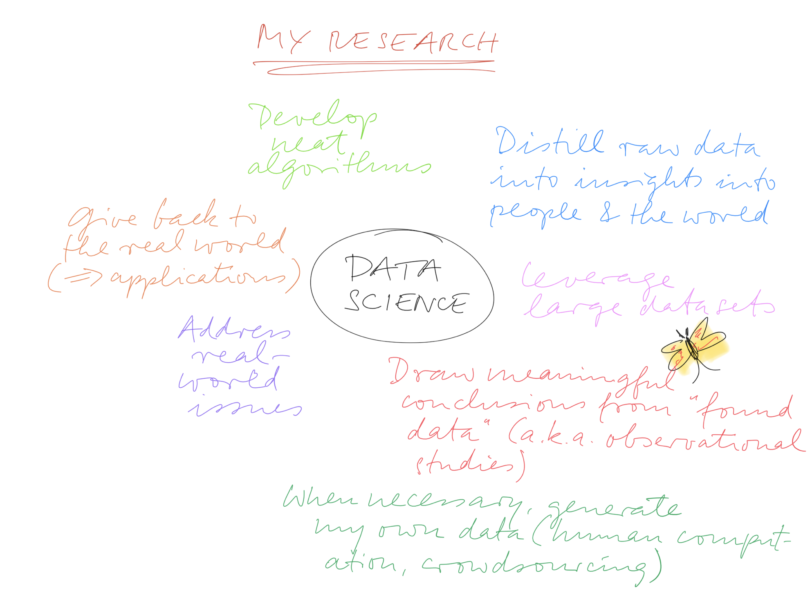

Slide 7
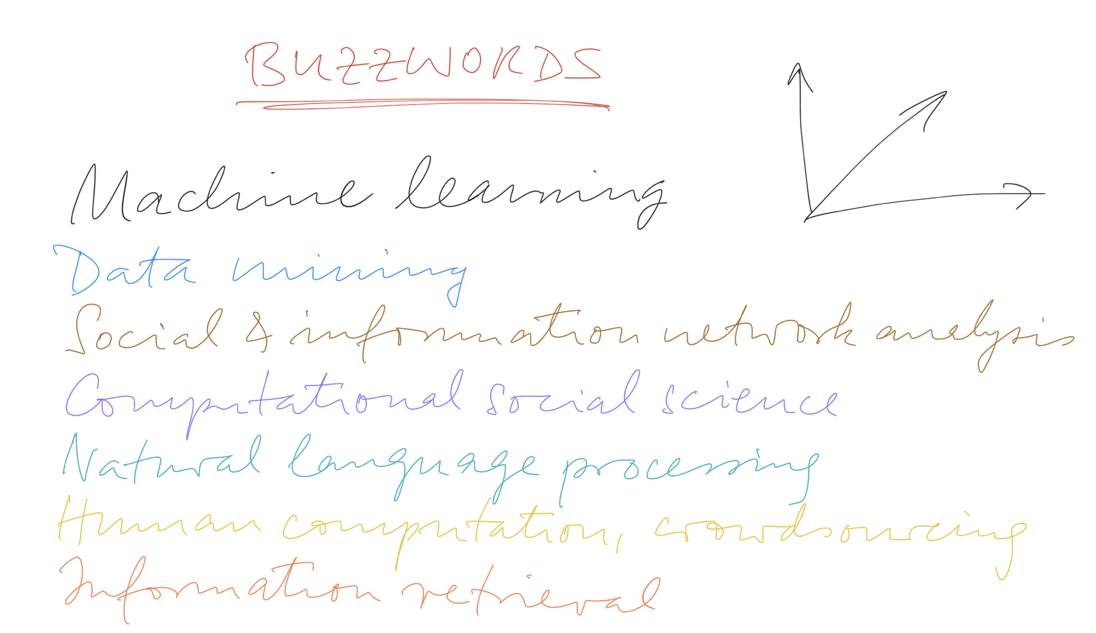
Notes:
Semester projects: motivated and top-notch students always welcome

Slide 8

Data analysis
“... the process of inspecting, cleaning, transforming, and modeling data with the goal of discovering useful information, suggesting conclusions, and supporting decision-making.”
“Data analysis has multiple facets and approaches, encompassing diverse techniques under a variety of names, in different business, science, and social science domains.”
Notes:
This was Bob West’s personal take on data science
Let’s quickly look at a more objective definition, from WP (you’ll notice, I love WP!)
(1) we’ll cover all of these!
(2) Attendees from all schools of EPFL

Slide 9
Applied data analysis
This course is about breadth, not depth
“What methods, principles, and tools are out there?”, rather than “How can I become an expert in deep learning for computer vision applied to images of cats?”
Data science is a fast-paced, shifting field
Obsessing on one tool or technique won’t pay off in a few years
Be ready to explore and keep learning on your own
Goal of this class: Enable you to conduct a full-fledged data science project from start to finish
That said, depth matters, too…
Complementary courses:
Machine learning
NLP
DIS
Data viz

Slide 10
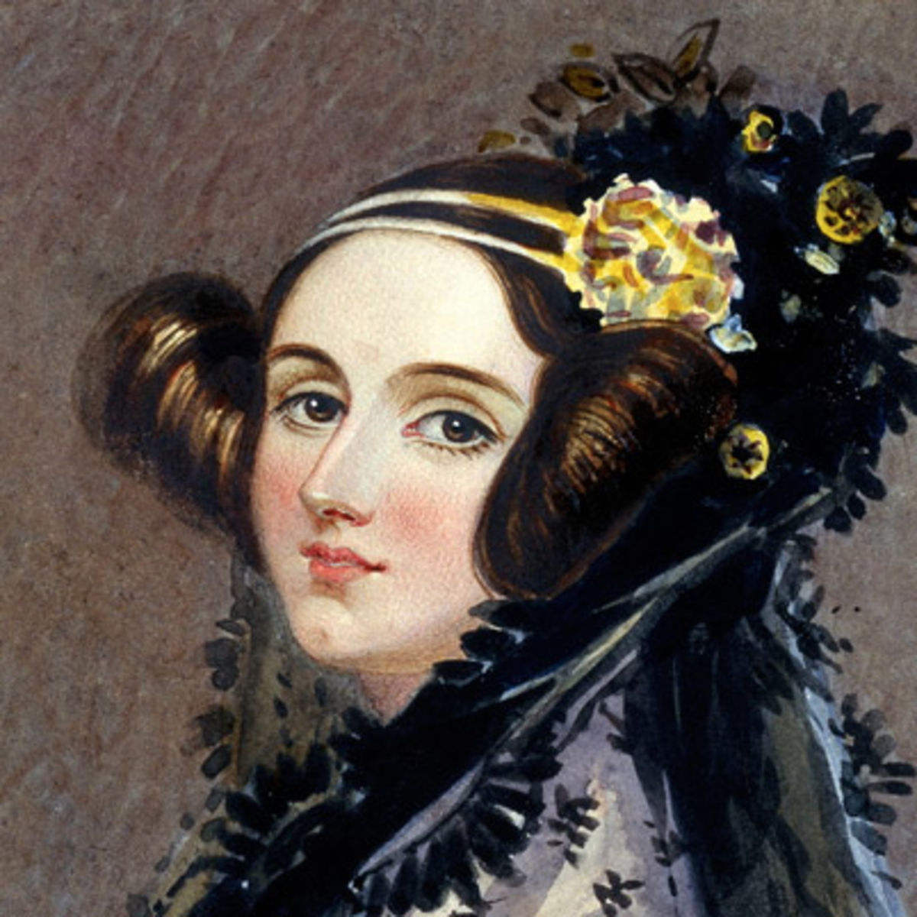
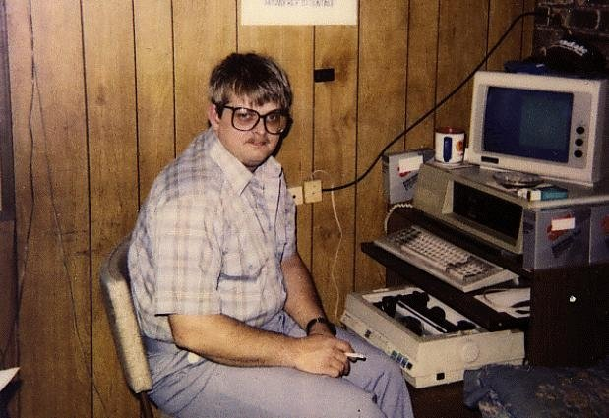
Let’s abbreviate this course as Ada, not A-D-A, in honor of Ada Lovelace, “the world’s first computer programmer.”
https://en.wikipedia.org/wiki/Ada_Lovelace
Notes:
Who knows who this lady is?
She is Ada Lovelace, the world’s first computer programmer, early 19th century
Good old days… sigh. We all know what has happened since then…
In honor of the good old days, let’s call the course “Ada”, not “A-D-A”

Slide 11
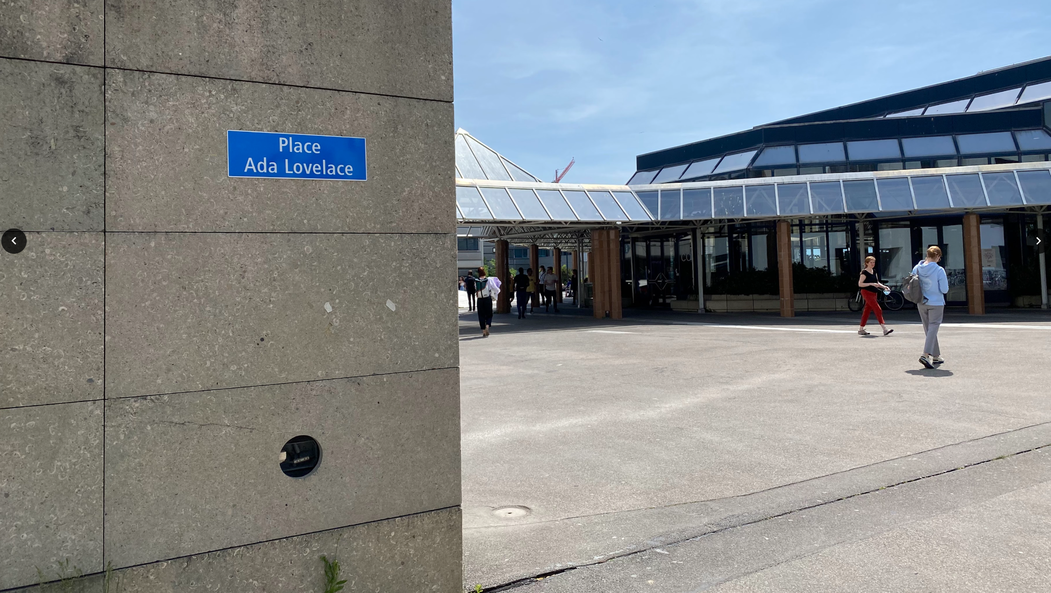
Notes:
In fact, to honor Ada Lovelace’s achievements, she has a place in the very heart of EPFL

Slide 12
Syllabus
Handling data
“Slicing and dicing”: obtaining, preparing, juggling data
Visualizing data
Exploration of data, communication of results
Describing data
How to support (and be suspicious of) claims about data
Regression analysis for disentangling data
How to disentangle datasets with correlated variables
Causal analysis of observational data
How to deal with “found data”
Correlation != causation
Notes:
Each bullet about one week

Slide 13
Syllabus (cont’d)
Learning from data
Supervised learning
Unsupervised learning
Applied aspects of machine learning
Handling specific types of data
Handling text data
Handling network data
Scaling to massive data

Slide 14

Grading
30% Homework assignments (2)
Involving skills required from data scientists
Groups of 5 students (may switch groups after Homework 1)
Homework of 2017, 2018, 2019, 2020, 2021, 2022
30% Final exam (date TBD)
Mini data analysis project
Done on laptop, individually, on campus
Final exams of 2017, 2018, 2019, 2020, 2021, 2022
25% Project (more details soon)
Your own freestyle data analysis
Done in groups of 5 students (same as for homework)
Milestones spread throughout the semester
Projects of 2017, 2018, 2019, 2020, 2021, 2022
15% Quizzes
Weekly, online (on Moodle), 5 questions in 10 minutes
Notes:
Deliverables scheduled such that there’s at most 1 thing at any point (no overlaps)
Teams: there will be mechanism to report freeloaders (red button); taken very seriously
Button must be pressed early on, so we can sort out the situation on time. The button is not intended as a post-hoc grade improvement!

Slide 15
Grading
30% Homework assignments (2)
Involving skills required from data scientists
Groups of 5 students (may switch groups after Homework 1)
Homework of 2017, 2018, 2019, 2020, 2021, 2022
30% Final exam (date TBD)
Mini data analysis project
Done on laptop, individually, on campus
Final exams of 2017, 2018, 2019, 2020, 2021, 2022
25% Project (more details soon)
Your own freestyle data analysis
Done in groups of 5 students (same as for homework)
Milestones spread throughout the semester
Projects of 2017, 2018, 2019, 2020, 2021, 2022
15% Quizzes
Weekly, online (on Moodle), 5 questions in 10 minutes
This class will be hard work,
but it will get you a job.

Slide 16
Grading (cont’d)
To obtain a meaningful grade distribution, scaling/shifting will be applied to each of {homework, project, exam, quizzes} before taking weighted average (standard practice at EPFL)
While intermediate grades are a good indication of where you stand, remember there might be some wiggle
→ Don’t rely on intermediate grades to decide whether you can afford to skip the exam etc.

Slide 17
Meeting logistics: Lectures
Wednesdays 8:15–10:00
If you want to see it live, come to class! (No live streaming)
Lectures are also recorded and made available after class

Slide 18
Meeting logistics: Lab sessions
Fridays 13:15–14:45
In person only:
BCH 2201 (next to UNIL)
CE 1 106
Labs are complementary to lectures, not simply more detail on same
You solve exercises that we make available the day before, can ask questions and get help from assistants
In certain weeks: homework/project office hours (probably on Zoom, in parallel to exercises)
Weekly online quizzes on Moodle (see next slide)

Slide 19
Weekly quizzes
Held online on Moodle
5 questions, to be answered within 10 minutes of starting
During first 15 minutes (13:15–13:30) of each Fri lab session
Week 1 (this week): no quiz
Week 2 (next week): Quiz 1: no real questions, just to let you get familiar with the setup
Week 3: Quiz 2: the first quiz that counts
Quiz i (held in week i + 1) is about lecture material of week i
Goal:
Engage continuously with course material
Think (not just find right slide)
No one is expected to get everything right
Your two lowest-scoring quizzes from entire semester won’t count

Slide 20
Project
We’ll provide a number of datasets
You need to form and pitch a crisp project idea
Free to combine with other datasets (at your own risk)
Goal: not a loose collection of results – tell a story with the data!
Data stories of 2017, 2018, 2019, 2020, 2021, 2022
Nice example data story
Notes:
When using own dataset: need to convince us that it’s feasible

Slide 21

Homework and projects: GitHub
De-facto standard for managing and sharing code
All students in this class need a GitHub account
Homework and project submissions done via GitHub
Notes:
Nice side effects:
Piggyback on GitHub timestamps for exact submission times
Can recognize freeloading

Slide 22
Main communication channel:
Class forum, available via Moodle
Also accessible directly, outside of Moodle: https://go.epfl.ch/ada2023-ed (sign in using the same email address as for Moodle)
Central place to ask all class-related questions
Mandatory! We’ll send important announcements on Ed only
Help each other (without cheating, of course)

Slide 23
Watch-at-home videos
Throughout the semester, we’ll release videos with supplemental information; e.g.,
Intro to lab sessions (already available!)
Project instructions
Homework 1 postmortem
Homework 2 postmortem

Slide 24
General note on communication
Multiple platforms used in ADA for various tasks (as in real life): Ed, GitHub, Google docs, ADA website
To avoid confusion,
familiarize yourself with communication guidelines
all materials will be linked from the website as a central point of entry: https://ada.epfl.ch
all discussions will take place on Ed

Slide 25
Group registration
Must form teams within 2 weeks, starting now (in time for release of Homework 1)!
Get started immediately to find 4 teammates
By Fri 6 Oct 23:59, complete the registration form (to be done by each team member individually): https://forms.gle/kEX3asGKPKRFBhN2A
Can change team after Homework 1 (but try to avoid it)

Slide 26

Prerequisites
Basics of
probabilities and stats
databases
programming
You won’t survive if you can’t program
Homework, exam: Python required
Project: up to you, but we support only Python
Brush up your Python skills (many great online courses out there)

Slide 27
Python environments
Homeworks and exams to be done as Jupyter Notebooks
You will submit a pre-executed .ipynb file
We don’t care how you produce it
Option 1: local Python installation (e.g., Anaconda + JupyterLab)
Option 2: Google Colab = notebook hosted by Google
Option 3: noto = notebook hosted by EPFL
To get started: come to Friday’s lab session (“Exercise 0”)
“Homework 0”: do it yourself at home after lab session (optional, not graded)
Doing Homework 0 is the best way of making sure you’re set up correctly for later homework, project, exam

Slide 28





Python++
Notes:
TF not covered explicitly

Slide 29


POLLING TIME
“What is your prior experience with Python?”
Scan QR code or go to https://web.speakup.info/room/join/66626
Notes:
What is your prior experience with Python? (Check all that apply.)
(A) I have never programmed in Python
(B) I have programmed at least one line of code
(C) I have done personal/class projects with Python
(D) I have used the Pandas library in Python
(E) I have used Jupyter notebooks
(F) I thought a Python was a snake, what the heck do you want from me?!

Slide 30


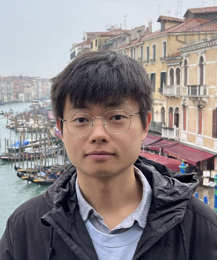

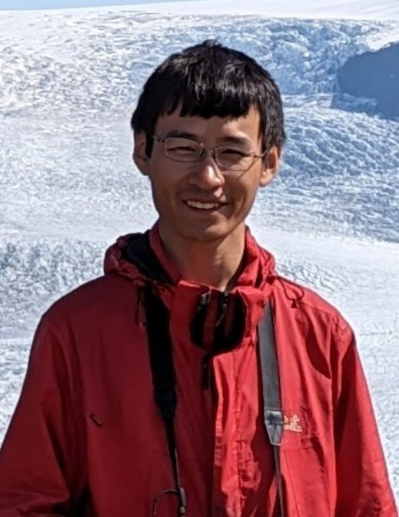
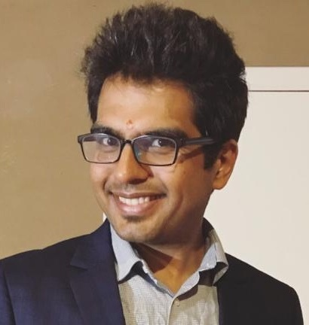



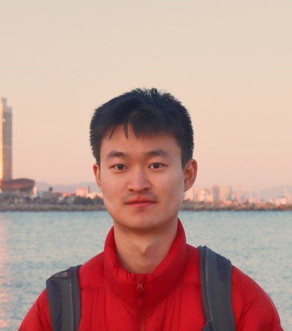

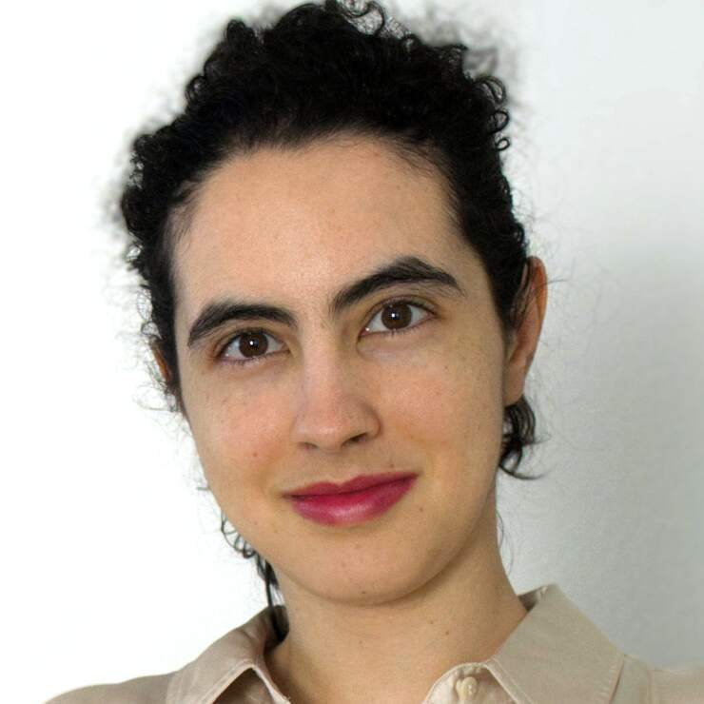
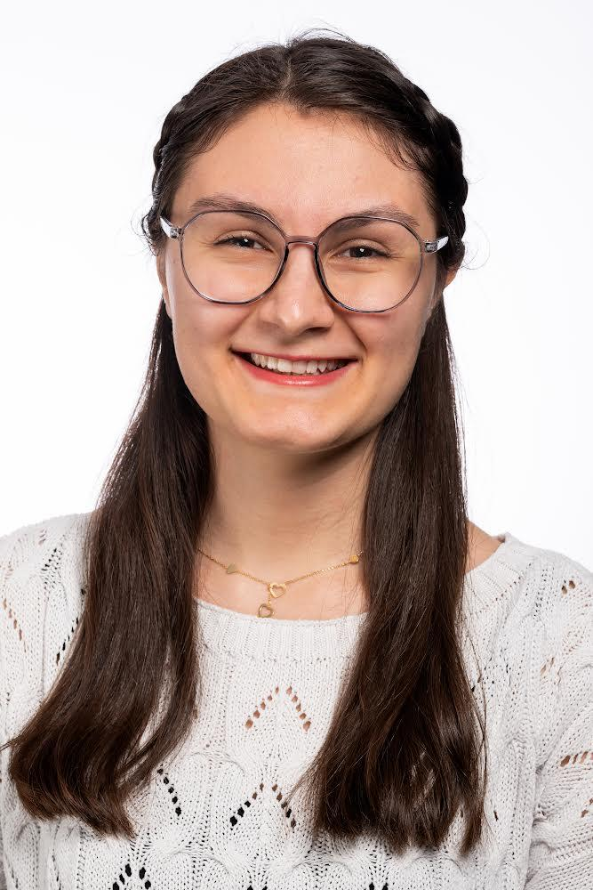


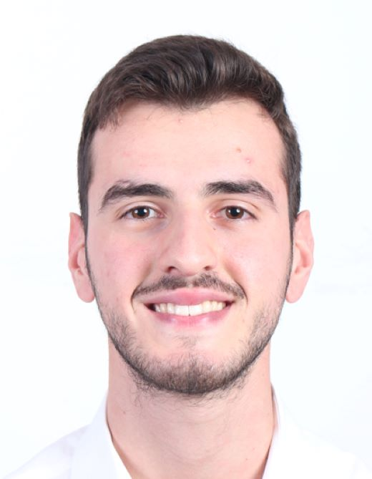
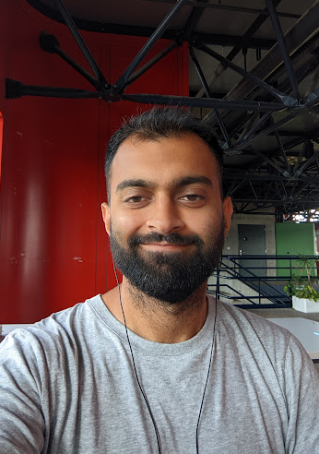

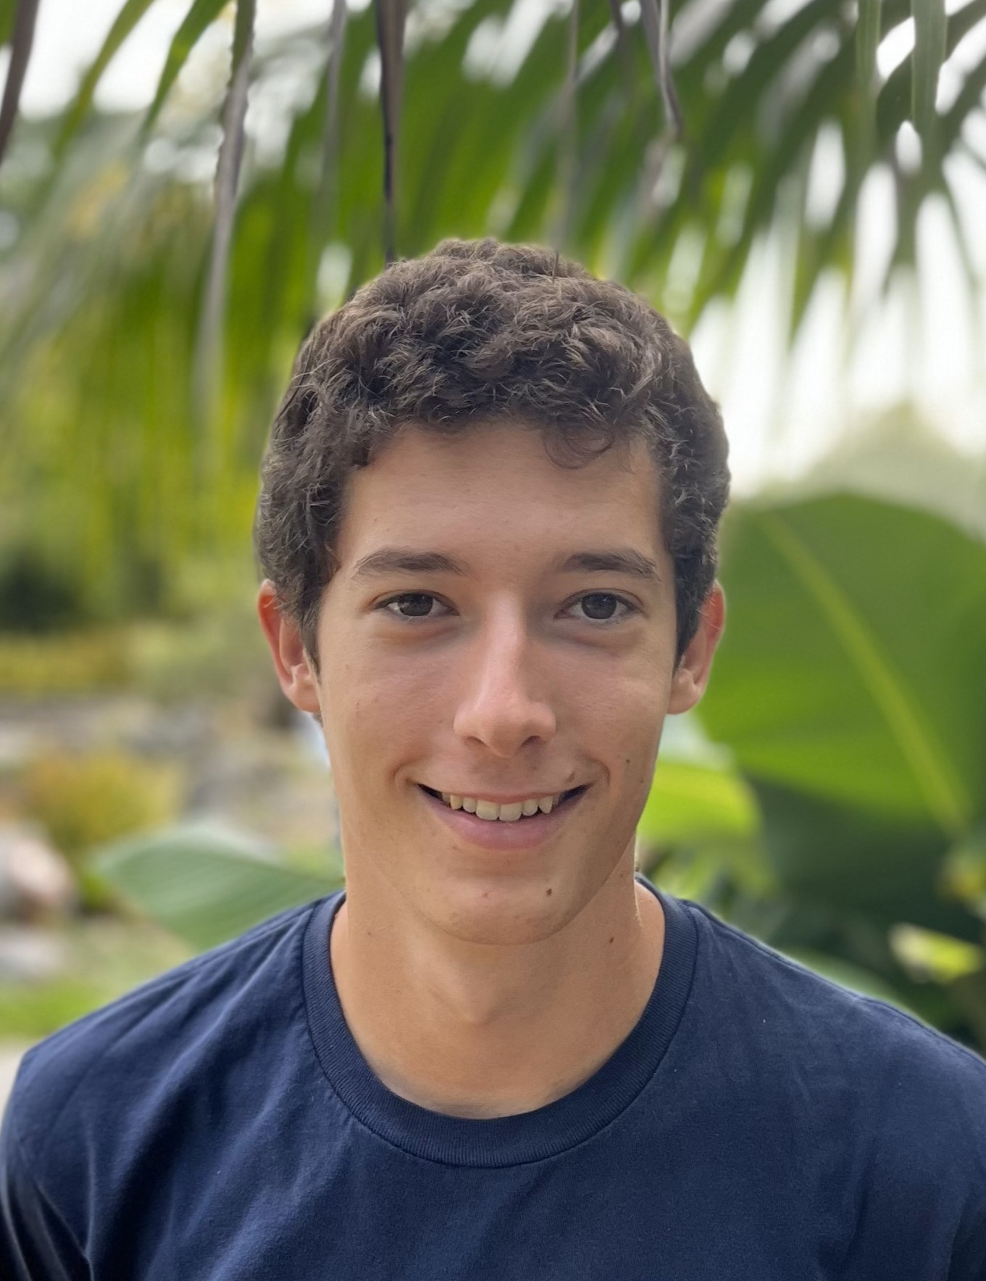
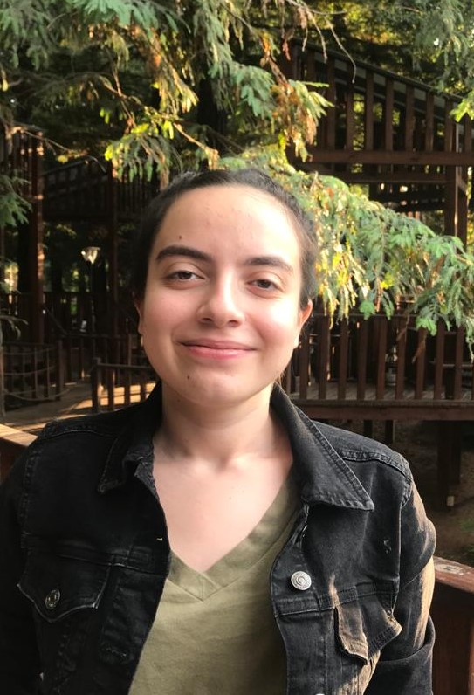

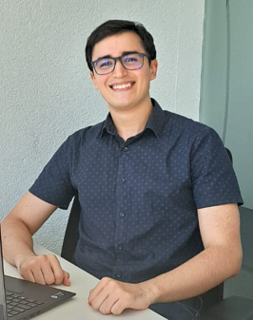
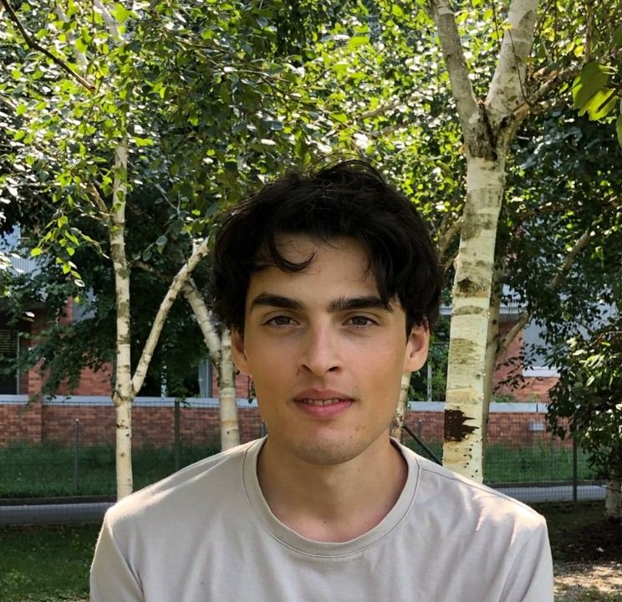



Instructor
Teaching assistants (TAs) = PhD students
Student assistants (SAs) = MS students
Bob
West
Akhil Arora
Manoel Horta
Saibo Geng
Mohammad
Masani
Silin Gao
Tim Davidson
Beatriz Borges
Sepideh
Mamooler
Marija Šakota
Aoxiang Fan
Martin
Josifoski
Terry
Zhang
Nearchos Potamitis
Berkay Döner
Riccardo Brioschi
Ali Waseem
Henrique da Silva
Hugo May
Elif Balcioglu
Lucas Burget
Boukil Farouk
Emanuele Nevali
Tommaso Martorella
Federico Di Gennaro
Pau Romeu Llordella
Notes:
Nearly everyone has taken the class, except me

Slide 31

Help each other on Ed
Participate actively in classes and labs
Give us feedback
Notes:
The team also includes YOU!
Although (and because!) this class is big, we want you to participate
…

Slide 32
Feedback
Give us feedback on this lecture here: https://go.epfl.ch/ada2023-lec1-feedback
Feedback form available for each lecture and lab session
What did you (not) like about this lecture?
What was (not) well explained?
On what would you like more (fewer) details?
What would you like the instructor to (not) wear next time?
…
Notes:
We take feedback seriously, have changed multiple things in response to feedback
Not always implementable in same year; see it as a multigenerational contract
Feedback not the only way in which we try to improve the class (p.t.o.)

Slide 33
Questions?

Slide 34
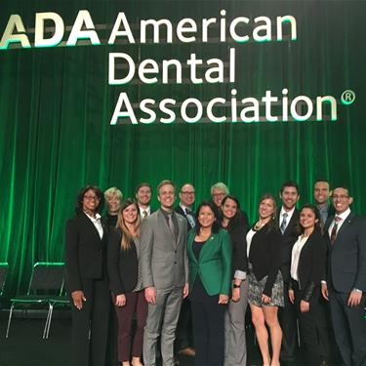
Commercial break
ADA students: sharp like teeth!

Slide 35
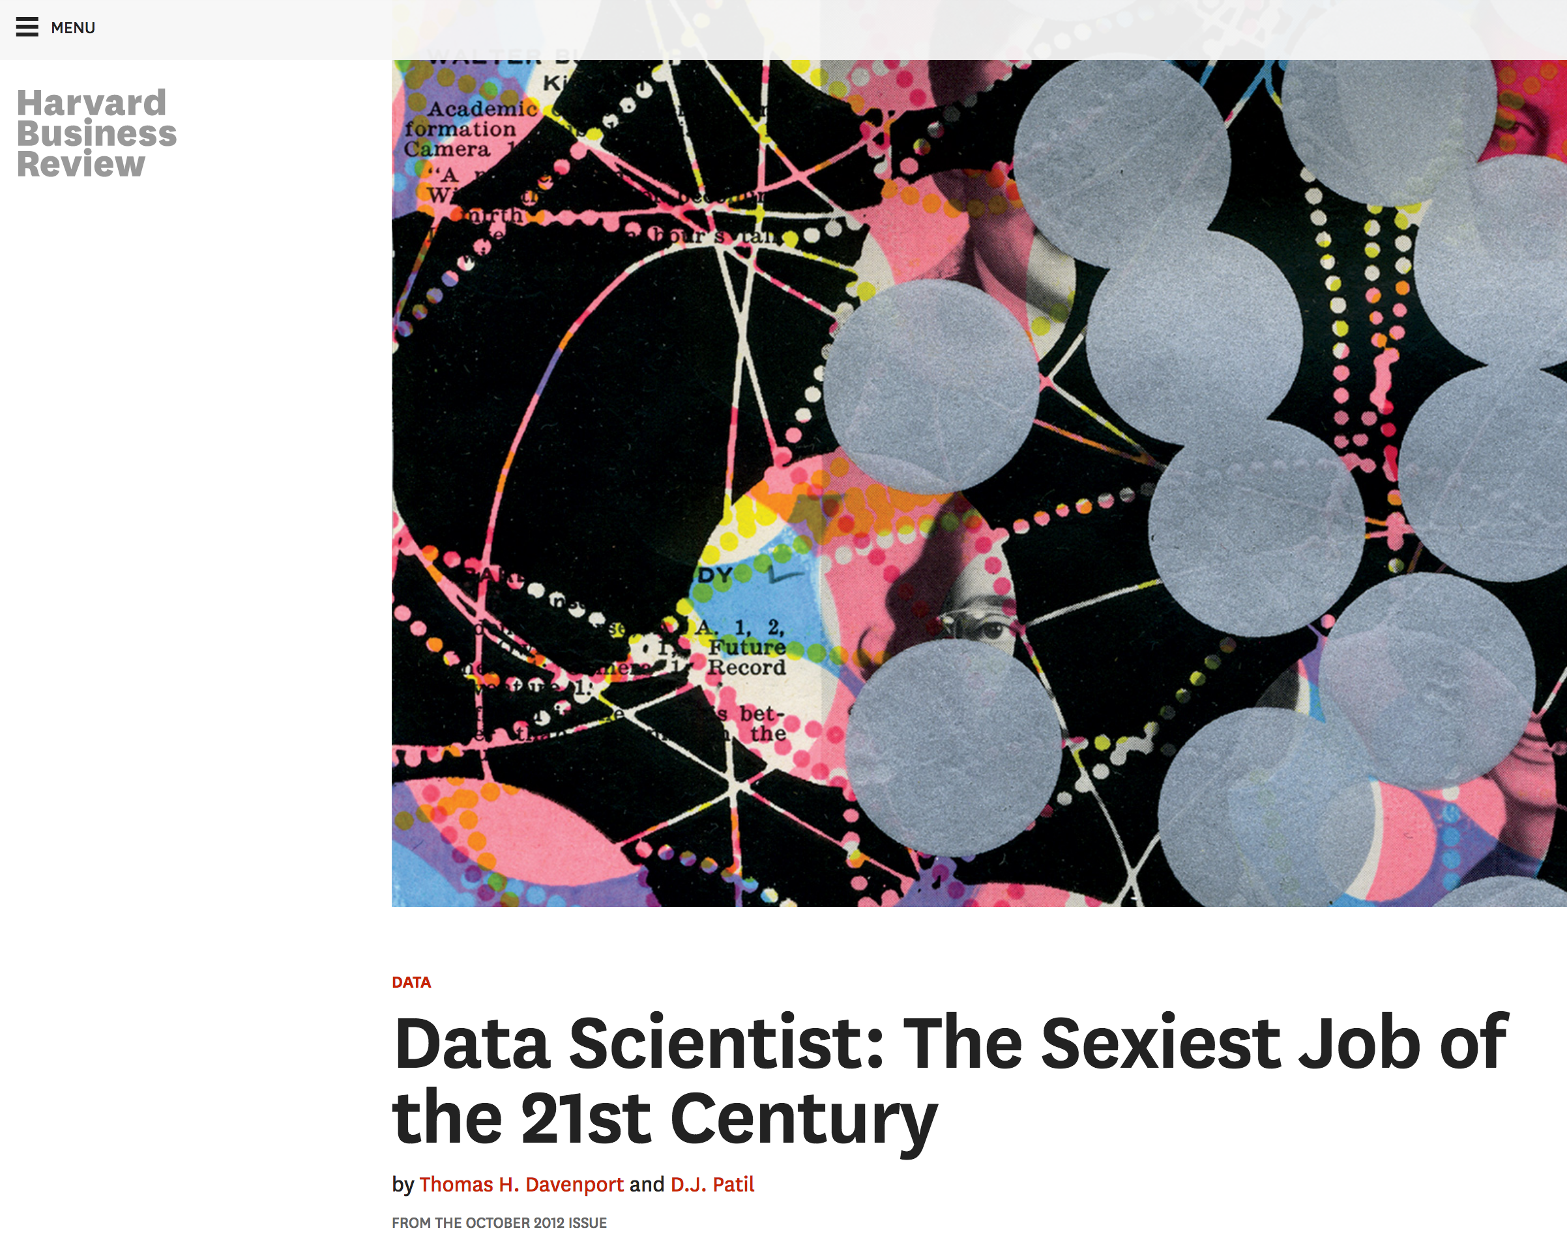
What is data science?
Notes:
10 years ago…

Slide 36
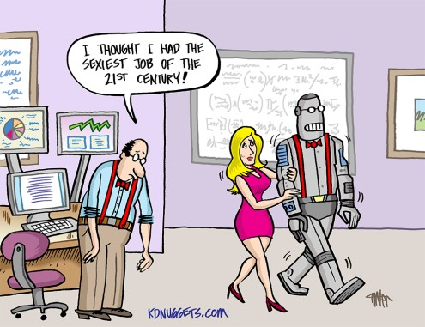
Why now?
I WISH I HAD BECOME A DATA SCIENTIST BACK IN 2023…
Notes:
Ok, so data scientist is the sexiest job of the 21st century -- but why should you become a data scientist now? [CLICK]
Because if you wait much longer, it might be too late

Slide 37
“Data science”
All science is (or should be) based on data, per definitionem
So how is “data science” different from plain old “science”?

Slide 38
Data volume explodes
“Between the dawn of civilization and 2003, we only created five exabytes of information; now [in 2010] we’re creating that amount every two days.”
Eric Schmidt, Google (2010)
Notes:
Much more data now

Slide 39
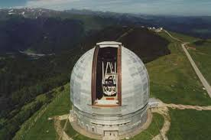
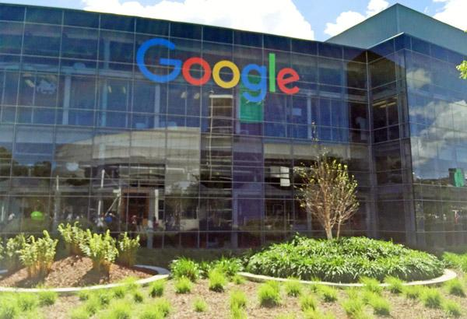
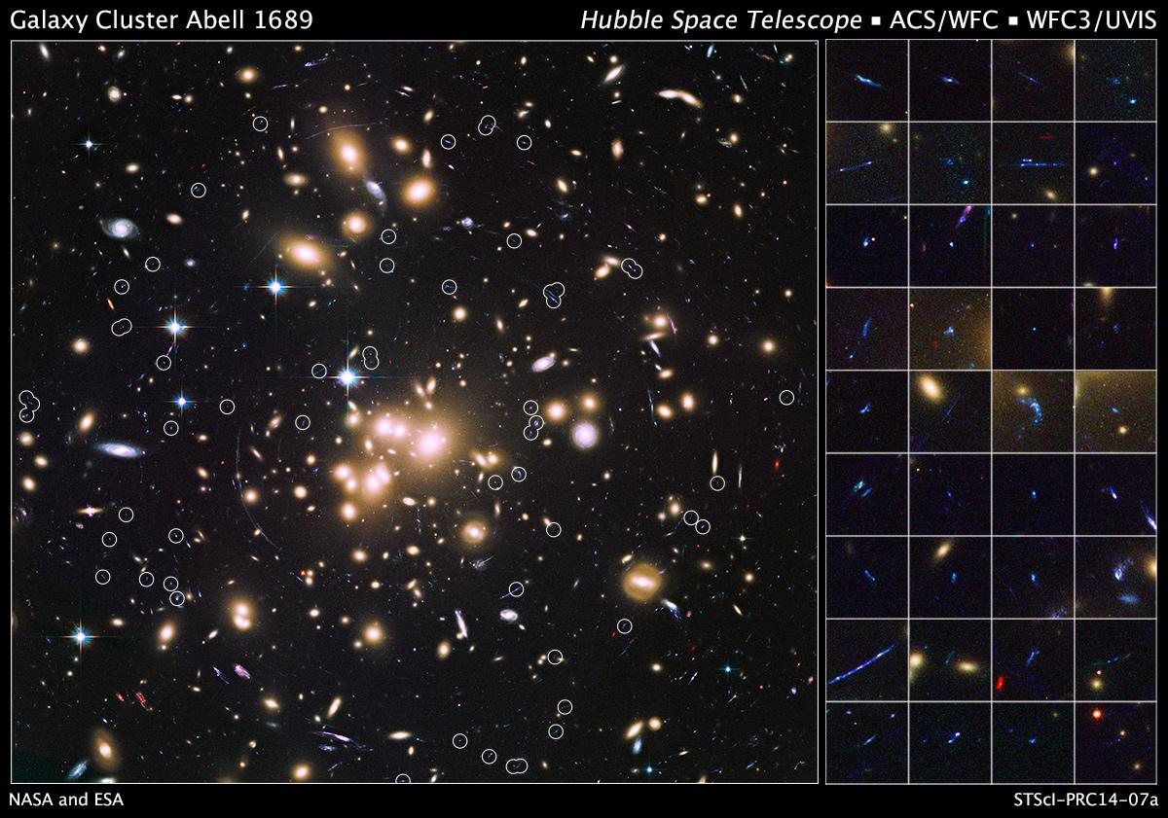
Data variety explodes
Text (indexed Web pages, email), networks (Web graph, Google+, knowledge graph), images, maps, logs (search logs, server logs, GPS logs), speech, …
Notes:
Some scientists have always been collecting huge amounts of data, e.g., astronomy
Now:
Everyone does
much more variety

Slide 40
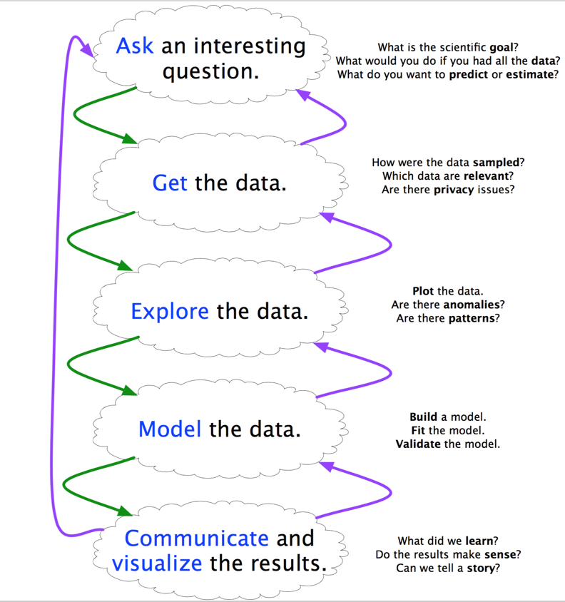
Needed: A method to the madness
Scientific method 1.0: - Focused on “Model the data” - Scientist has hypothesis prior to analyzing the data
Scientific method 2.0: - Systematic cycle (see diagram) - “Explore the data” becomes increasingly important - Data as a first-class citizen
Notes:
…
Different from typical ML approach, which starts from algorithm, uses data at the very end for validation
Here we start from data, and keep it in the loop all the time, as our first-class citizen
[diagram] -- data science also a meta science (how to do science when you have tons of data?)

Slide 41
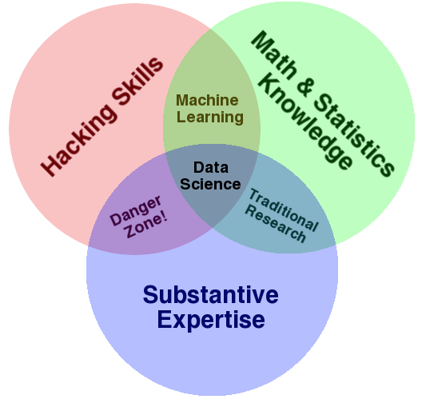
Scientist 2.0

Slide 42
“A data scientist is someone who can obtain, scrub, explore, model, and interpret data, blending hacking, statistics, and machine learning. Data scientists not only are adept at working with data, but appreciate data itself as a first-class product.”
Hilary Mason, chief scientist at bit.ly

Slide 43
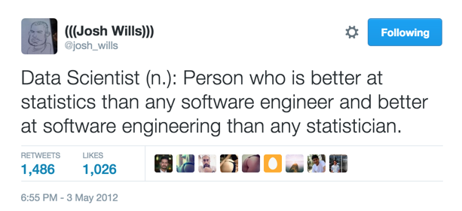
Josh Wills, Data Scientist at Slack

Slide 44
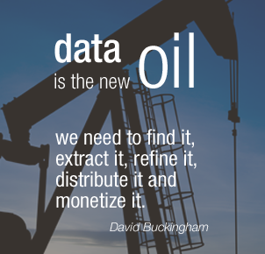
Notes:
Not only science is changed by data -- the whole world is
Economical aspects: …
oil/data is often hard to obtain; precious; but both need to be refined, into plastic/fuel/medicine or insights/products
Value comes only from insights (downstream product, as with oil)

Slide 45
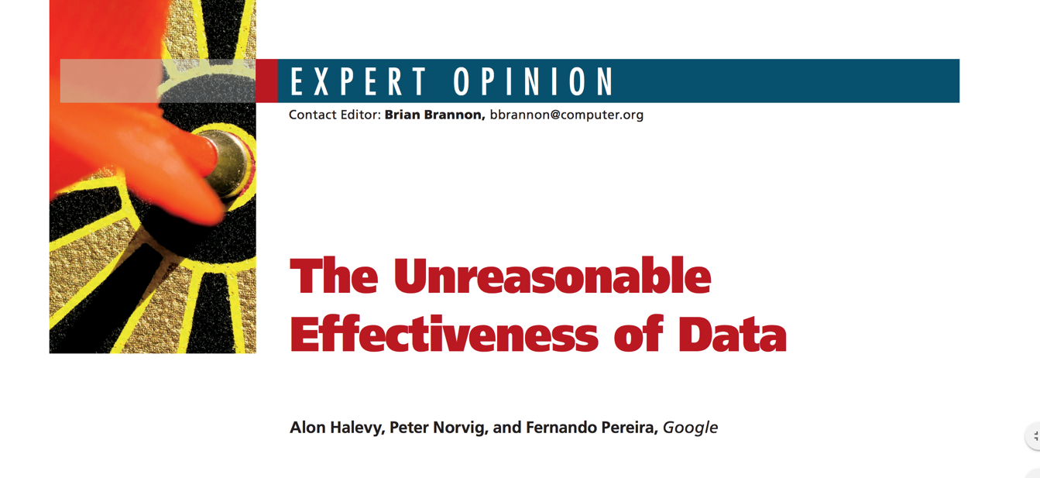
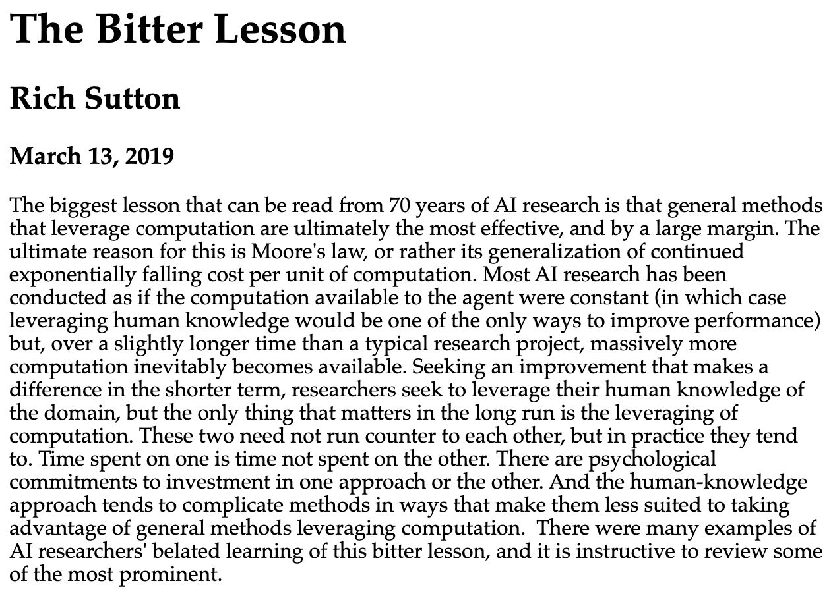
More data often beats better algorithms
http://www.incompleteideas.net/IncIdeas/BitterLesson.html

Slide 46


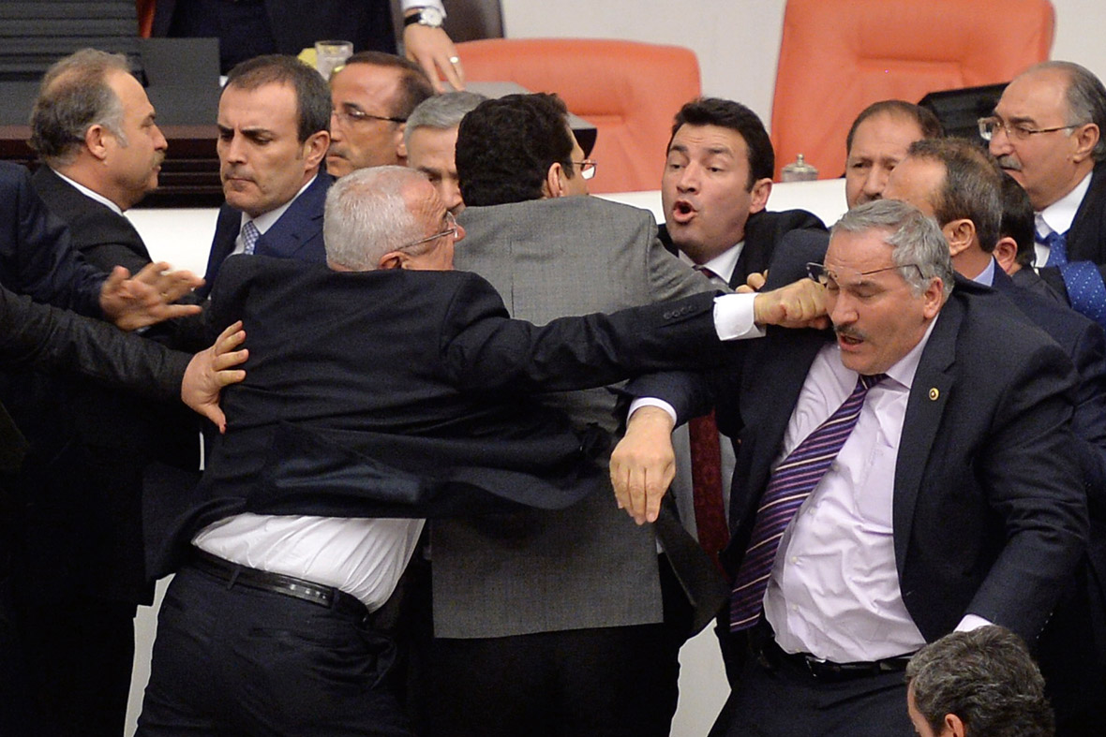
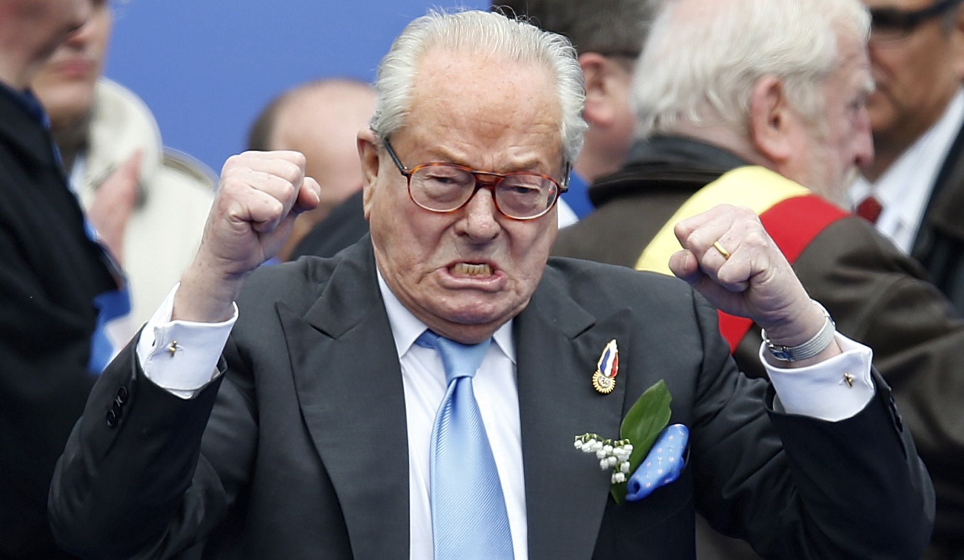
21st-century politics
Notes:
Data science also becomes increasingly important to understand the societies we live in
E.g., the public perception is that politics in recent year has become less respectful, more negative and less fact based

Slide 47
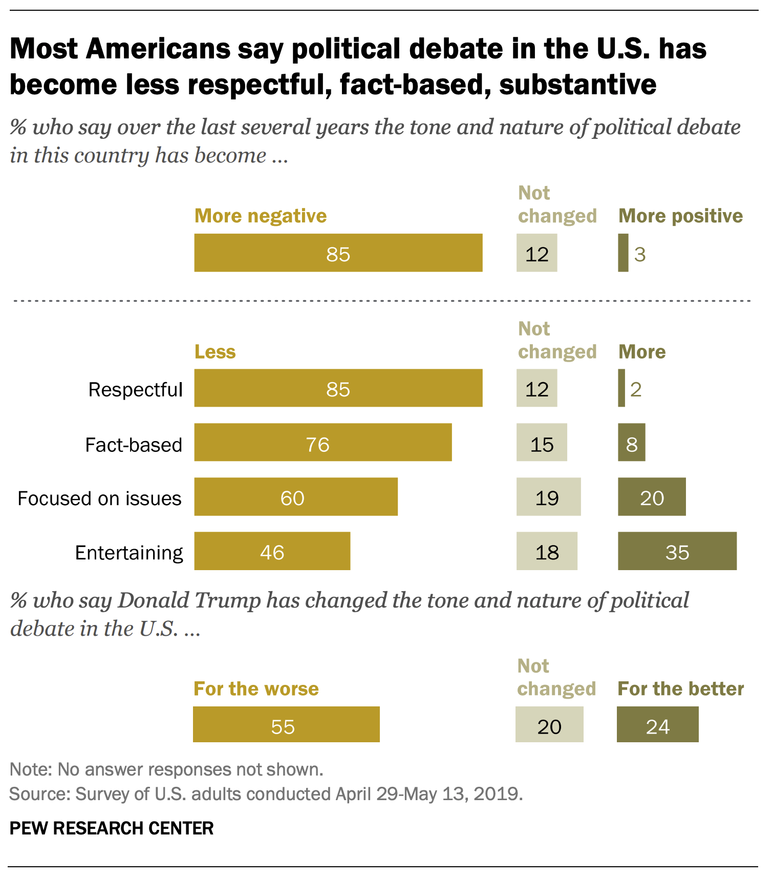
We ask: Do these subjective impressions reflect the true state of US political discourse?
ADA will teach you the tools to answer such questions using data (see next slides)
https://www.pewresearch.org/politics/wp-content/uploads/sites/4/2019/06/PP_2019.06.19_Political-Discourse_FINAL.pdf
Notes:
in the US, for instance, in 2019, pew research found that 85% of americans found that news coverage had become more negative (among other things)...
In work done in my lab we asked whether these subjective impressions reflect the true state of US political discourse.
ADA will teach you …

Slide 48

Syllabus, revisited
Handling data
Visualizing data
Describing data
Regression analysis for disentangling data
Causal analysis of observational data
Learning from data
Handling text data
Handling network data
Scaling to massive data
Data: https://github.com/epfl-dlab/Quotebank
Web interface: https://quotebank.dlab.tools/
Notes:
Handling data: used a massive dataset of 235M quotes extracted from raw news text and automatically attributed to speakers of those quotes – noisy dataset. The student who created the dataset spent more than half of this MS thesis on dataset cleaning

Slide 49
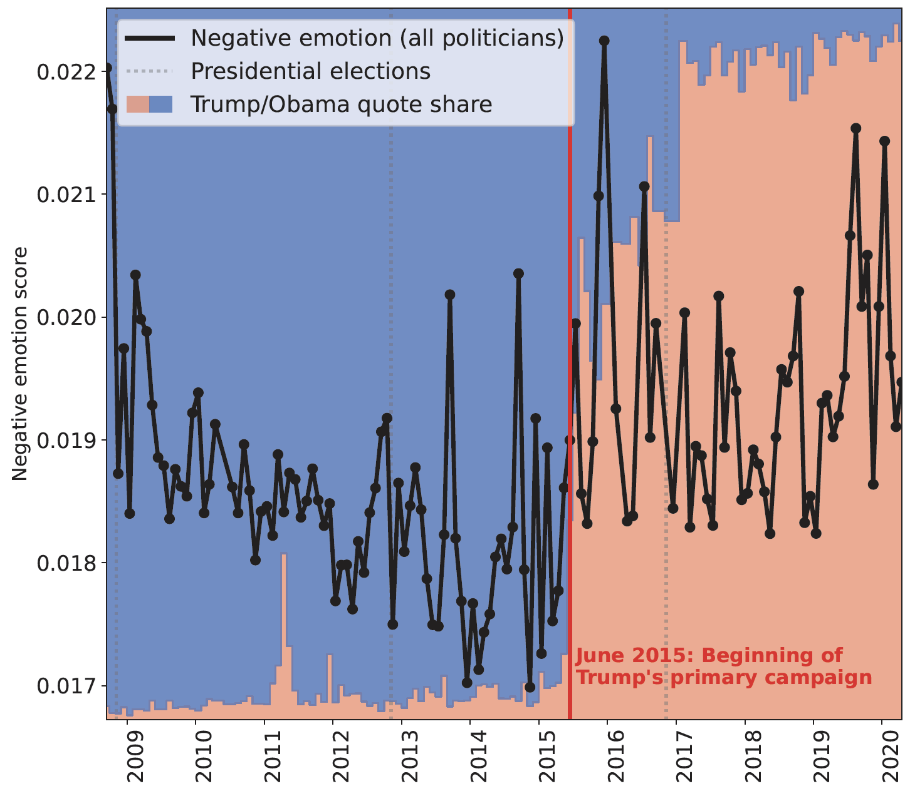
Syllabus, revisited
Handling data
Visualizing data
Describing data
Regression analysis for disentangling data
Causal analysis of observational data
Learning from data
Handling text data
Handling network data
Scaling to massive data
Notes:
Note how much info is shown: Trump moves to the fore, and at the same time quotes become more negative

Slide 50
Syllabus, revisited
“Is the effect real, or could it have been produced by chance?”
Handling data
Visualizing data
Describing data
Regression analysis for disentangling data
Causal analysis of observational data
Learning from data
Handling text data
Handling network data
Scaling to massive data
Notes:
Visualization an intuitive way of describing data. But is the effect real or could it have been produced by chance?
→ The Q of statistical signif (p.t.o.)

Slide 51
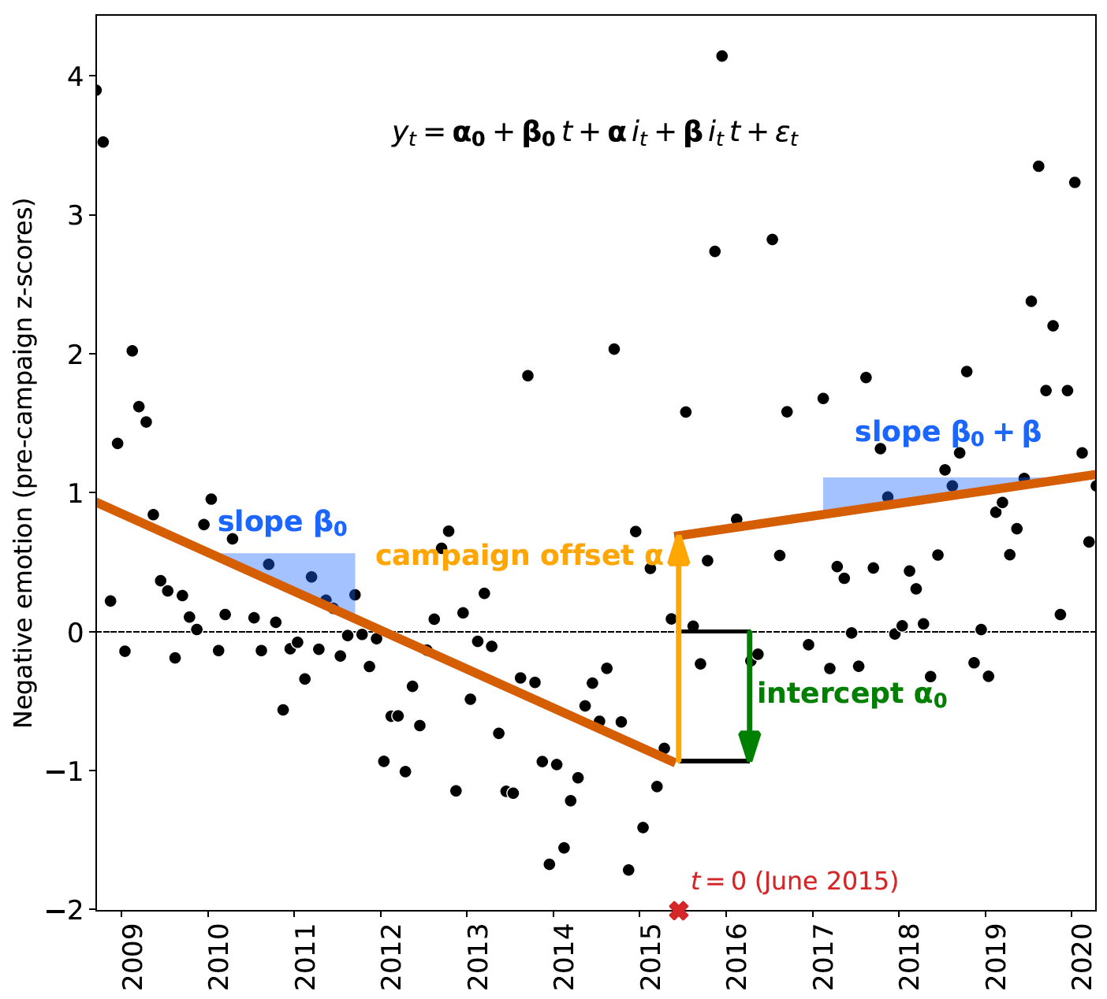
Syllabus, revisited
Handling data
Visualizing data
Describing data
Regression analysis for disentangling data
Causal analysis of observational data
Learning from data
Handling text data
Handling network data
Scaling to massive data
Notes:
One way to quantify significance is via regression analysis
Allows us to determine whether there really is a jump in June 2015, or whether it’s but a figment of the imagination

Slide 52
Syllabus, revisited
Handling data
Visualizing data
Describing data
Regression analysis for disentangling data
Causal analysis of observational data
Learning from data
Handling text data
Handling network data
Scaling to massive data
“What caused the observed increase in negativity?”

Slide 53
Syllabus, revisited
Handling data
Visualizing data
Describing data
Regression analysis for disentangling data
Causal analysis of observational data
Learning from data
Handling text data
Handling network data
Scaling to massive data
Quotes were attributed to speakers by a machine learning algorithm

Slide 54
Syllabus, revisited
Handling data
Visualizing data
Describing data
Regression analysis for disentangling data
Causal analysis of observational data
Learning from data
Handling text data
Handling network data
Scaling to massive data
Research question (“Did political discourse become more negative?”) is a question about language == text

Slide 55
Syllabus, revisited
Handling data
Visualizing data
Describing data
Regression analysis for disentangling data
Causal analysis of observational data
Learning from data
Handling text data
Handling network data
Scaling to massive data
In follow-up work we ask: “Who speaks about whom in what way?” → Construct “who-mentions-whom” network

Slide 56
Syllabus, revisited
Handling data
Visualizing data
Describing data
Regression analysis for disentangling data
Causal analysis of observational data
Learning from data
Handling text data
Handling network data
Scaling to massive data
Extracting 235 million quotes from 127 million news articles (about 1 terabyte of raw text) spanning 12 years requires big-data tools (e.g., Spark)

Slide 57
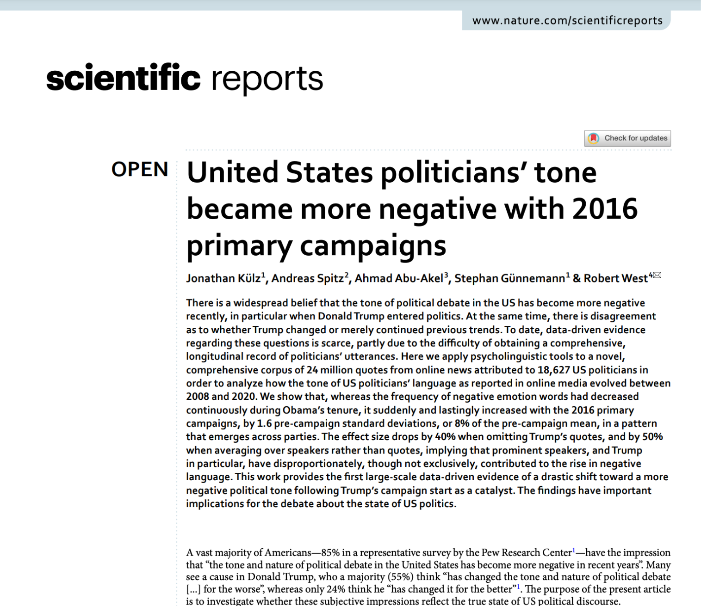
Curious to learn more?
Full paper available at https://www.nature.com/articles/s41598-023-36839-1

Slide 58
TODO before Friday’s lab session
Sign up for Ed here and familiarize yourself with it
If you’re not on GitHub yet, sign up for GitHub
Start looking for 4 teammates
You may use “Group formation” category on Ed
Check out Google Colab and noto (to see if you want to use either of them)
Check out Exercise 0 here (in prep for Fri lab session)
Notes:
Exercise 0 will be uploaded Thu morning

Slide 59
Any feedback? -- Let us know!
Give us feedback on this lecture here: https://go.epfl.ch/ada2023-lec1-feedback
Feedback form available for each lecture and lab session
What did you (not) like about this lecture?
What was (not) well explained?
On what would you like more details?
What would you like the instructor to wear next time?
…

